Slide 1
Cycling Project

Slide 2

Background
‘Adventure Works’
A fost infiintanta in May 2011.
Compania are bances around
The world
O analiza profitabilitatii si a produselor oferite sa ne indice performanta
The company sells bicycles and related equipment. Its aim is to encourage the sport of cycling throughout the world

Slide 3
Obiective Analizei
Sunt Sales seaonal? Factori posibil (sarbatori, evenimente politice sau majore, anotimpuri)
Este o fluctuatie upward/downward trend in performanta companiei over the months and years? Factori posibili pentru rezultate (prodtipuri de use, discounts, erori in cum a fost adaugata data)
Tipurile de produse vandute si categoriile de produse care s-au vandut cel mai bine.
Intervalurile luate in analiza
Iunie 2011 si iunie 2014

Slide 4
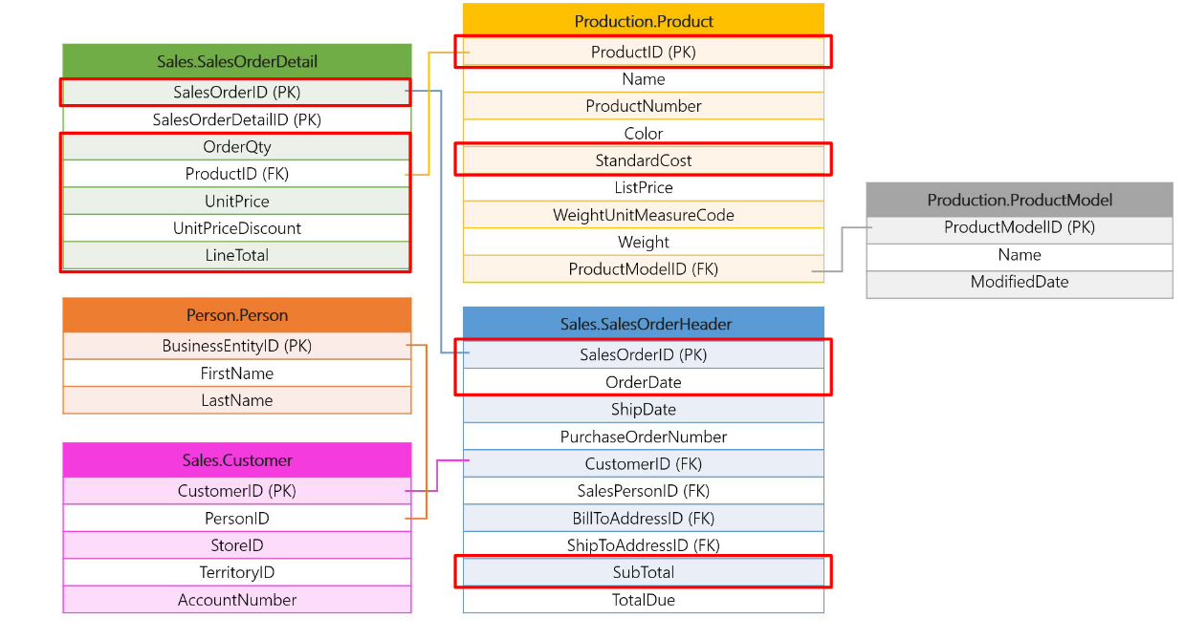
Diagramele/Tabele folosite in Analiza

Slide 5
Annual Revenue/Profits/Quantity Sold
SaleYear | Revenue | Profit | TotalQtySold
2013 | 43622479.05 | 3653934.589 | 131788
2014 | 20057928.81 | 3479394.36 | 61659
2011 | 12641672.21 | 1631285.791 | 12888
2012 | 33524301.32 | 1134796.8046 | 68579

Slide 6
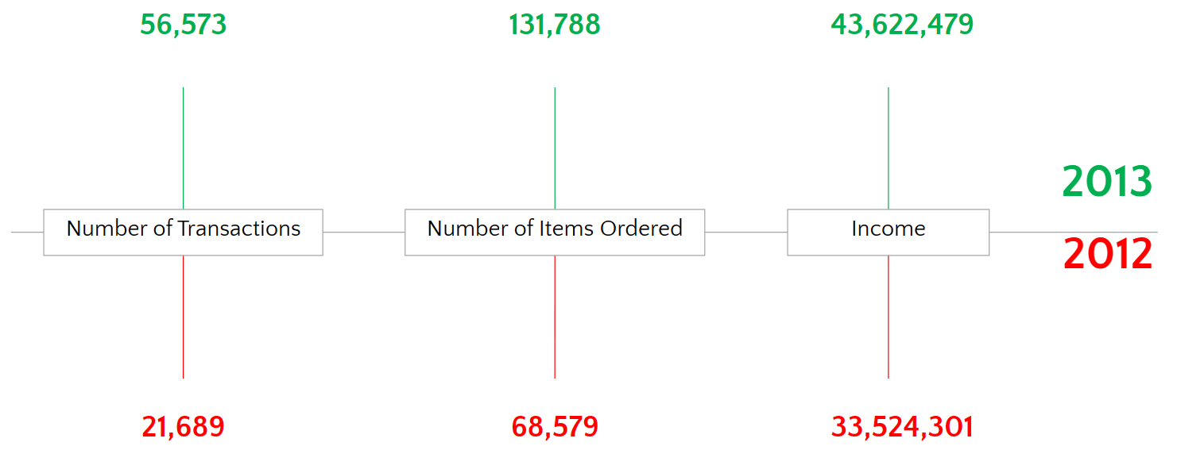
Comparison 2012/2013

Slide 7
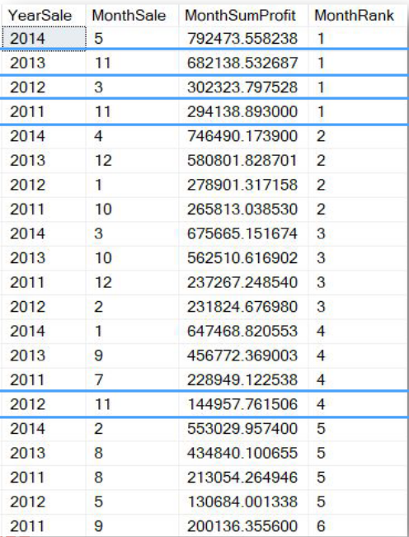
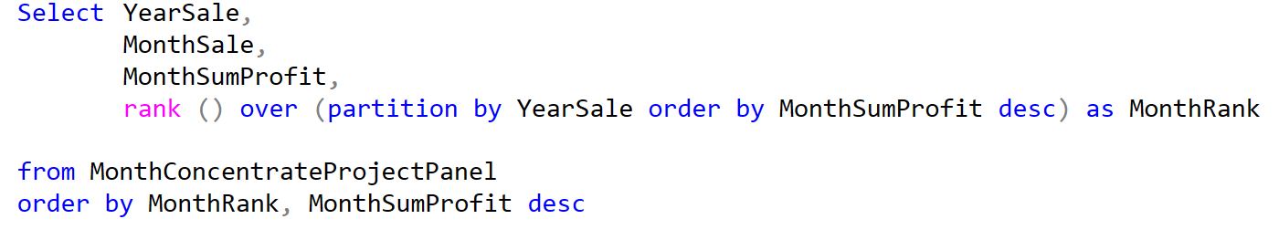
Monthly Profits/Rankings

Slide 8
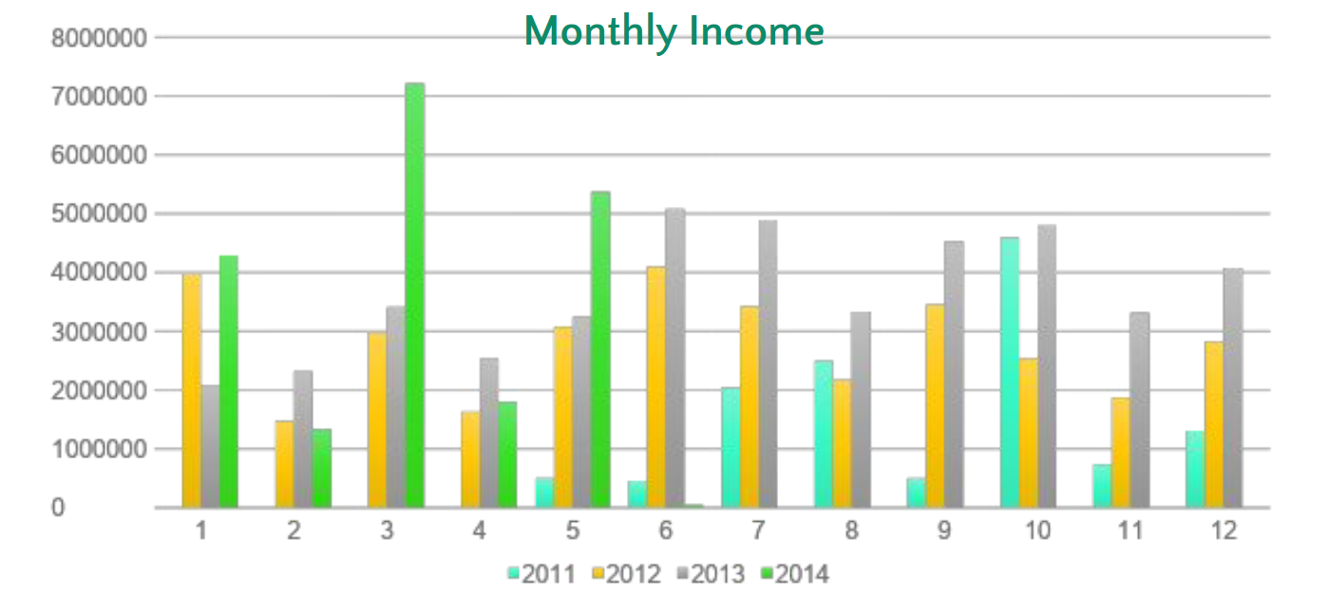
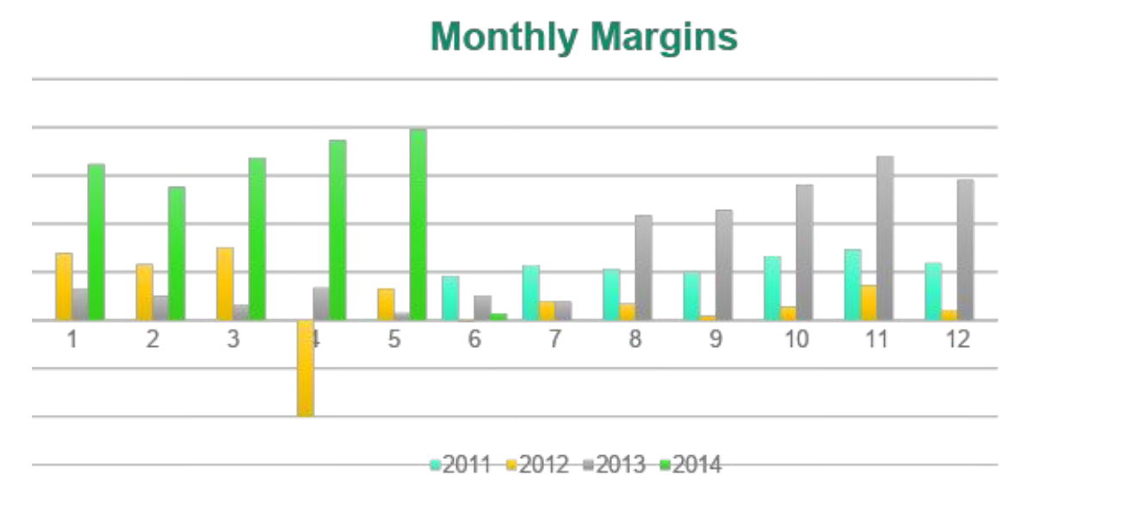
Monthly

Slide 9
Monthly rankings/quarter
Output-ul rezultat oferă informații despre lunile mai profitabile dar si despre cele mai puțin profitabile. Identificarea tiparelor poate ajuta compania să planifice activități promoționale în perioadele de rang inferior pentru a crește vânzările și profitabilitatea
Din datele obtinute, iunie si iulie luna 6 si respective 7 au o tendinta de crestere, ceea ce coreleaza cu anotimpurile mai calde, unde demand-ul de biciclete si avgtiviti sportive este sporit. De asemenea, luna a 11-noiembrie si ea indica o foarte mare crestere, probabil din activitati promotionale (Black Friday) sau tensinta oamenilor de a cumpara cadouri inainte de Sarbatori.
Overall, positive monthly results throughout the months/years with 2013, being the strongest one (vedem strong monthly profits and margins).

Slide 10
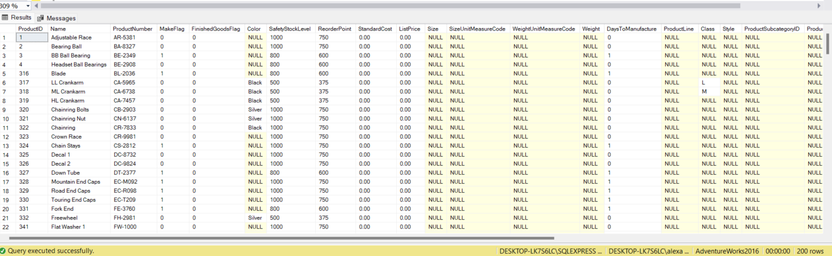
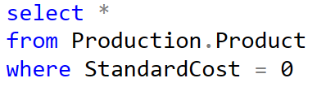
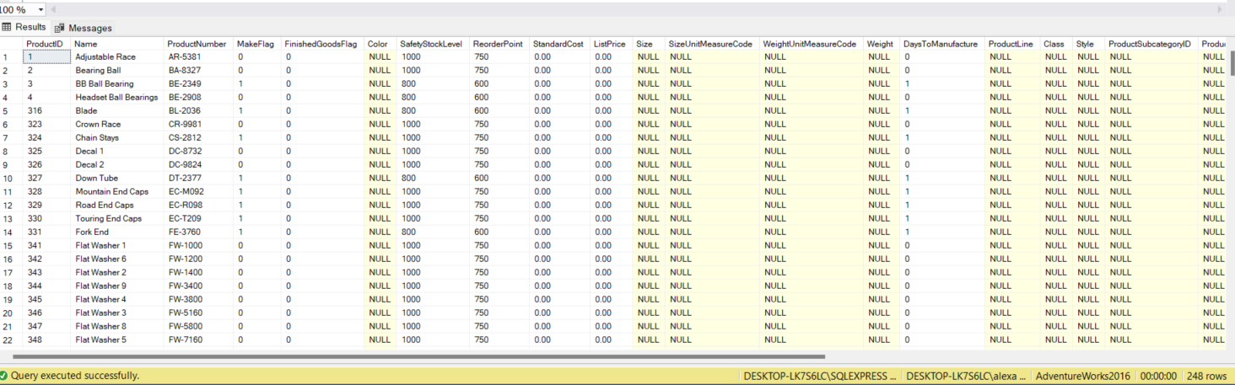
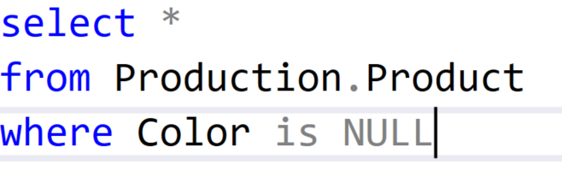
Checking Integrity of Revenue –Standard Cost/Color is Null

Slide 11
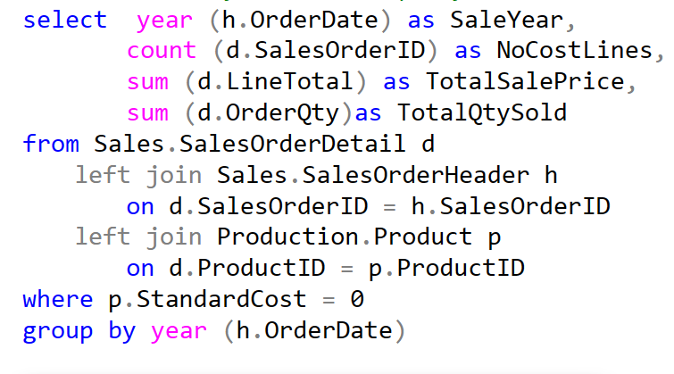
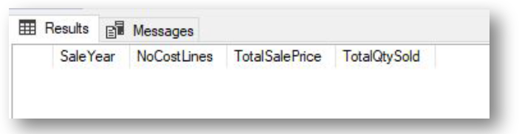
Integrity Check – Checking how many items sold per year without cost

Slide 12
Findings
It is important to check if there are orders without
cost data, as this affects the profitability calculations
Sunt 200 rows without costs si 248 without color, so not enough to affect revenue calculations.
Cand am calculate numarul de produse vandute cu un pret 0, nu a rezultat nimic., so it’s safe to say the data is accurate and relevant for our calculations.

Slide 13
Top selling products

Slide 14
Findings
From previous slide, we can see consistent sale of bicycles for all models for all the years. From this, we can conclude Company should keep focusing on the sale of bicycles as their main target, however from Top 5 products of all time table below, accesorries sell as well, with strong margins, thus generating high revenues.
ProductID | Name | StandardCost | ListPrice
879 | All-Purpose Bike Stand | 59.466 | 159
876 | Hitch Rack - 4-Bike | 44.88 | 120
710 | Mountain Bike Socks, L | 3.3963 | 9.5
709 | Mountain Bike Socks, M | 3.3963 | 9.5
877 | Bike Wash - Dissolver | 2.9733 | 7.95

Slide 15
Concluzii
O prima concluzie rezultata ca urmare a analizei output-ului obtinut este ca societatea este una generatoare de profit si venituri semnificative
An upward trend in both revenue and profit throughout the years.
Anul 2013 a fost foarte bun, cu revenue up 20 percent and number of transactions and number of items ordred almost doubled.
Se pare ca e seasonal cu lunile 5 si 6 fiind cele mai puternice, ceea ce indica ca vanzarile sunt seasonal, cu lunile mai calde de vara fiind mai advantajate.
In anul 2014 a fost o deviere de standard cost(unde a fost 0) probabil atribuita faptului ca informatia nu a fost adaugata cum trebuie. (user error)
There is a strong demand for a divdersief product offerings,(din tabelul top products) so the company can add even more items and accessories to increase sales. O gama mai diversificata de produse sa atraga si mai multi clienti

Slide 16
Recomadari
There is a strong demand for a divdersief product offerings,(din tabelul top products) so the company can add even more items and accessories to increase sales. O gama mai diversificata de produse sa atraga si mai multi clienti
Oferirea de promotii in jurul lunilor mai slabe
Companie sa se focuseze pe their main product category (bikes) but should also focus on adding more accesorries that complement the prduct mix.
Should offer bundles and pachete promotionale to encourage more sales.
Compania sa try to replicate what they did in 2013 to have better results in the future.

